Slide 1
ZOO MANAGEMENT SYSTEM
Shubham Maratha(230)
Abhishek Jadhav(233)
Hrushikesh Dolas(238)
Namam Madariya(230)

Slide 2
CONTENTS
INTRODUCTION
BACKGROUND
REQUIREMENT ANALYSIS
ER DIAGRAM
SCHEMA DIAGRAM
DATA STRUCTURES
OUTCOME AND OUTPUT
CONCLUSION

Slide 3
INTRODUCTION
The Zoo Management System facilitates the Customer to enquire about the wild life and visiting details available on the basis of location and timings, Booking and Cancellation of tickets, enquire about the status of the booked ticket, etc. Online booking has made the process for the reservation of tickets very much easier than ever before. It’s a system of managing the duties and status of all kind of worker and employees. Here animal loving people search for an animal and get the whole info, they can even search with their availability at the zoo.

Slide 4
BACKGROUND
In earlier days, Zoological gardens provide an opportunity to open up a whole new world of curiosity and interest, and sensitize visitors regarding the value and need for conservation of wildlife. Zoos were initially started for the entertainment of people. Gradually over the years, they have come to play an important role in conservation. The ultimate goal of zoos is the conservation of animals .The entire detail of the ZOO PARK and to elaborate more on providing the visitors entry tickets, keeping the animals’ details and maintaining their birth, death& updates. Zoos faced the problems of issuing a ticket and maintaining the animal’s data by manually. It takes more time and difficult to maintain. The data are stored in MS Excel. This leads to the difficulty of calculating the data.
Zoo management system will find a new way to overcome the above problem that will help to provide the tickets effectively without any corrupted data or information and to provide a security data base to store all animals’ details. By this way, the history record can be maintained without much manual effort and storage of paper. So this reduces the usage of papers which in turns helps to keep Green Environment

Slide 5
REQUIREMENT ANALYSIS
User requirements:
Easy to use and handle.
Booking tickets from anywhere as per the provided details and timings.
All guidance option should be available before hand.
User should get detailed information about every animal , employees and their booking.
System should be able to update at regularly intervals.
It should be secure and reliable.

Slide 6
SOFTWARE REQUIREMENTS
DATABASE: My SQL , PHP
FRONT END:
HTML , CSS, JAVA SCRIPT

Slide 7
ENTITY-REALTIONSHIP DIAGRAM
Various entities identified in the system are Customer, Employee, Ticket, Zoo, Animal Guide etc. The entity and its attributes are describing the relation between each other.
Constraints for the ER diagram:
Object | Relation | Object
CUSTOMER | Books Cancels | Tickets Tickets
ZOO | Has Has | Animal Employee
EMPLOYEE | Handle Serves | Animal Customer
ANIMALS | Have | Employee

Slide 8
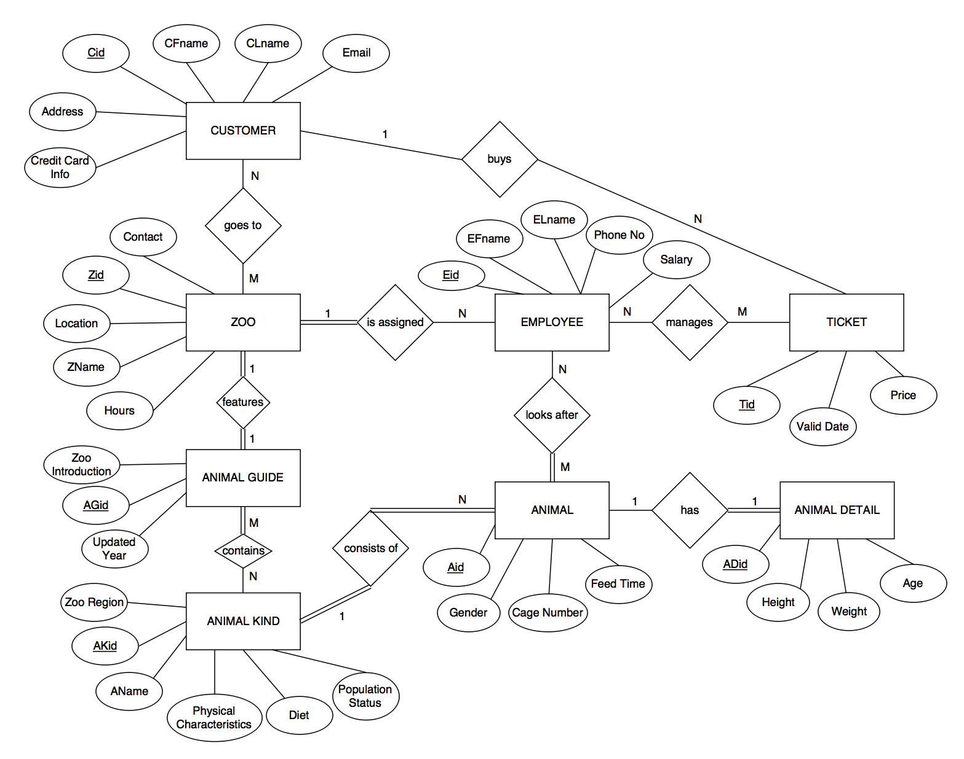
ENTITY-RELATIONSHIP DAIGRAM

Slide 9
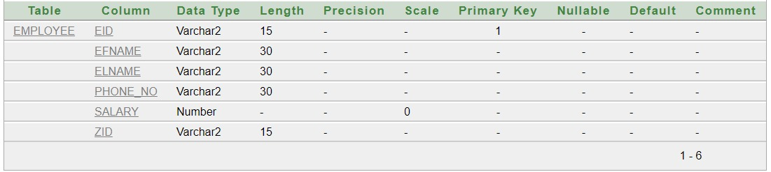
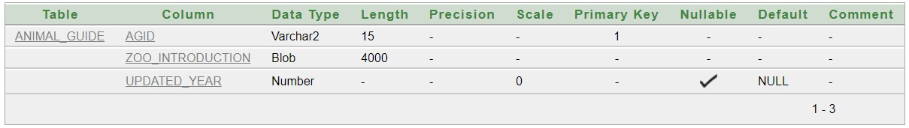
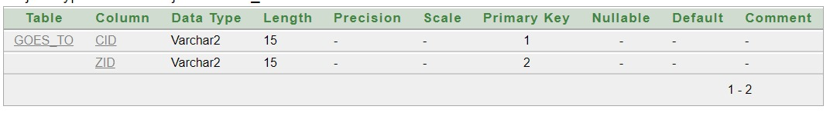
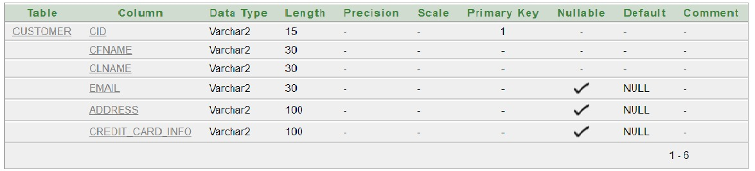
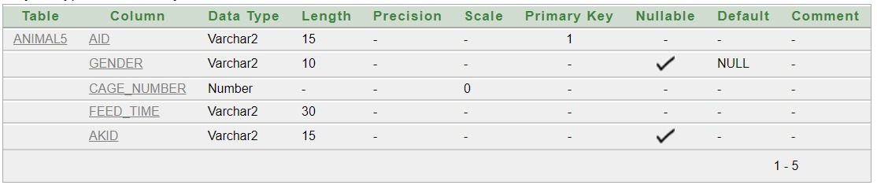
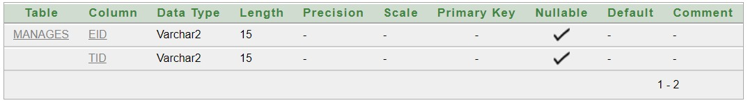
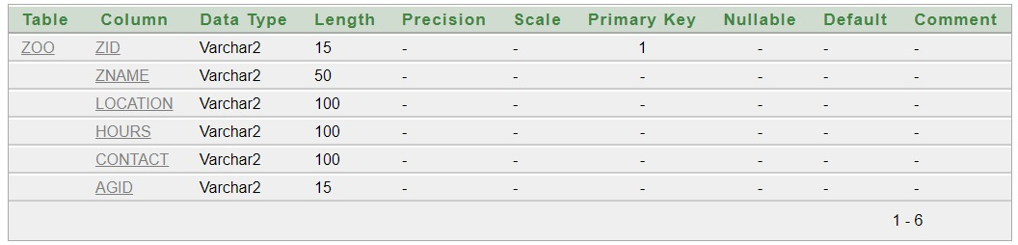
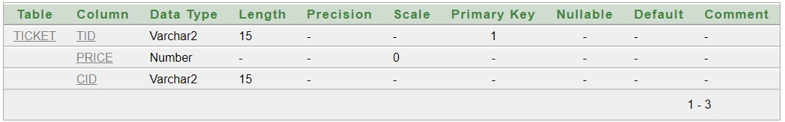
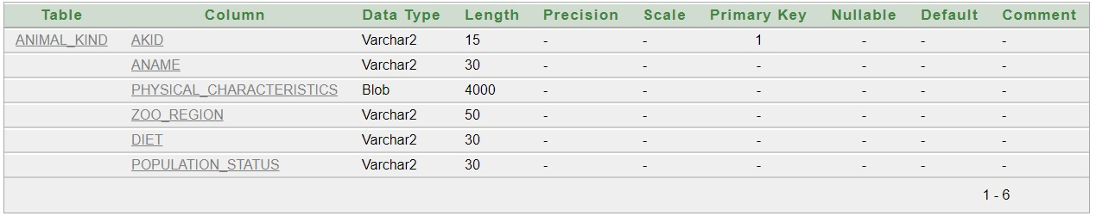
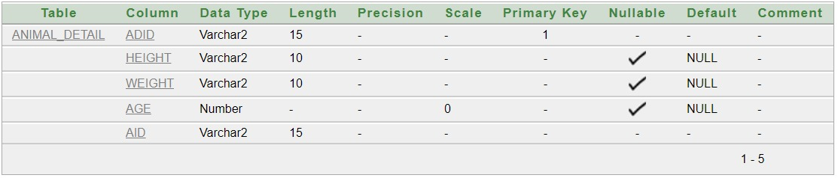
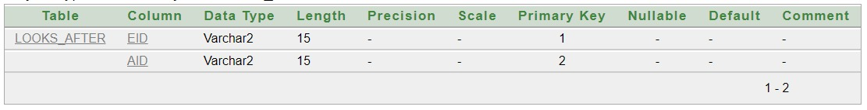
SCHEMA DIAGRAM

Slide 10
DATA STRUCTURES
Linked list :
Linked list of registration of customers can be used to simulate the visits for Employees over array of objects as number of registrations included by different customers vary accordingly.
Binary Search Tree – for Animal, booking Information :
Binary search tree can be used to store Animal and Customer details and Visits information as the whole information can be retrieved within least time according to customer requirement.
Priority Queues – for tickets :
When the passenger wants to make reservation, one can check the details of the flight.The information can be stored in priority queues giving priority to the reservations that makes easy service of the passengers.

Slide 11
OUTPUT AND OUTCOMES
Output Set :
Output= {Ticket_Allotment , Booking_confirmation, Logout }
Outcomes
Customers search for the zoo and Ticket details and access information regarding the bookings after login.
Customers and Employee add and update the information and details.
Customers can make reservation by checking zoo timing details.
Zoo management system keeps the track of bookings and manage/update the bookings and detail information about Zoo.

Slide 12
CONCLUSION
Customers can confirm tickets online instead of traditional method of ticket confirmation.
User ,visitors as well as Zoo Employee is able to keep the details of visits.
This system can be used in order to minimize waiting times, prioritize Ticket confirmation.
This allows individuals to conveniently and securely reserve their entries to zoo online. Compared to the usual traditional method, queuing method, the web-based management system could significantly increase customer and visitor satisfaction and reduce total waiting time and efforts effectively of visitors as well as the employees.

Slide 13
THANK YOU

